Slide 1

Excel Functions – Logical, Text & Date-Time Functions
Data Analytics

Slide 2
Learning Objectives
By the end of this session, learners will be able to:
Understand and apply logical functions (IF, AND, OR)
Use nested functions for complex decision-making
Perform text manipulation using Excel functions
Clean and format textual data
Work with date and time functions in Excel
Perform calculations using date-based functions

Slide 3
Schedule Breakup
Section | Duration
Introduction | 10 mins
Logical Functions | 40 mins
Nested Functions | 35 mins
Break | 10 mins
Text Functions | 35 mins
Date-Time Functions | 25 mins
Doubt Resolution | 15 mins
Wrap-up | 10 mins
Total | 180 mins (3 hrs)

Slide 4

Logical Functions
What are Logical Functions?
Logical functions evaluate conditions and return TRUE or FALSE.
Common Use Cases:
Grading systems
Tax calculations
Error handling
Data validation.

Slide 5
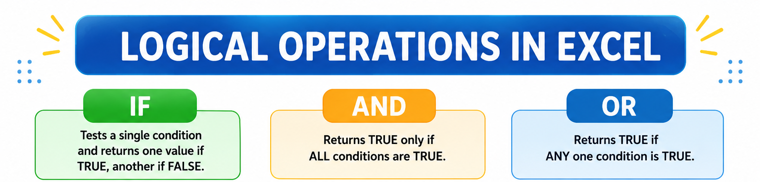

Slide 6
IF Function
Definition: The IF function is a logical function in Excel used to test a condition and return one value if the condition is TRUE and another value if the condition is FALSE.
Syntax:
  logical_test → The condition you want to check (e.g., A2 ≥ 40).
  value_if_true → What Excel should display if the condition is TRUE.
  value_if_false → What Excel should display if the condition is FALSE.
=IF(logical_test, value_if_true, value_if_false)

Slide 7
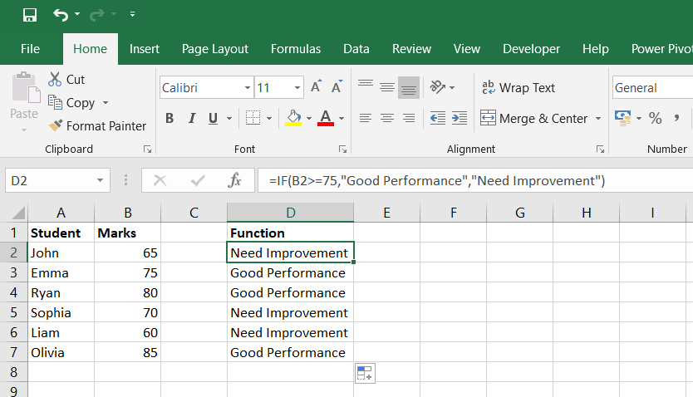
IF Function
Example : Check whether a student scored good or needs more practice.
=IF(E2>75, "Good Performance", "Need Improvement")

Slide 8
IFS Function
Why use IFS instead of Nested IF?
Problem with Nested IF:
For multiple conditions, using many IF statements inside each other (nested IFs) makes the formula long, hard to read, and error-prone.
Example of Nested IF:
=IF(A2>=90,"A",IF(A2>=80,"B",IF(A2>=70,"C","Fail")))
Looks confusing when conditions increase.
Solution – IFS Function:
IFS allows you to test multiple conditions in a cleaner way, without nesting.
It improves readability and maintenance.

Slide 9
Syntax of IFS
=IFS(logical_test1, value_if_true1, logical_test2, value_if_true2, …)
logical_test1 → The first condition to check (e.g., A2 ≥ 90).
value_if_true1 → Result if the first condition is TRUE.
Continue with as many conditions as needed.
Important: IFS doesn’t have a direct “else” option → To handle all other cases, use TRUE as the last condition.

Slide 10
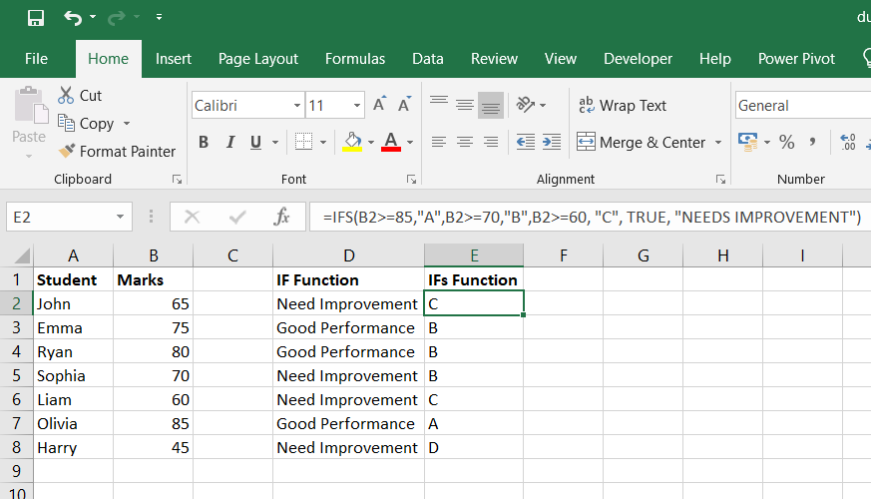

Slide 11
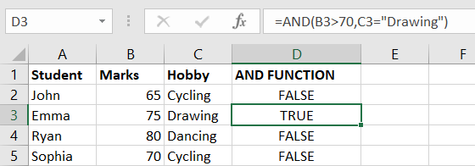
ADD Function
AND Function : Returns TRUE if all arguments are TRUE.
Syntax :
Example : Check whether the student is a boy and has a hobby of dancing.
=AND(B2 > 70,C2 = “Drawing”)
It will return either true or false.
=AND(condition1, condition2, ...)

Slide 12
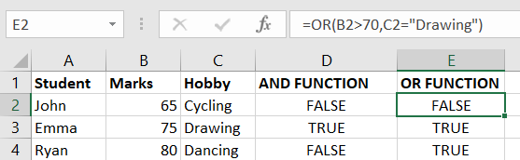
OR Function
OR Function : Checks whether any of the arguments is true and returns true or false. Returns False only if all the arguments are false.
Syntax :
Example : Check either the student is female or has scored more than 90 marks.
=OR(B2 > 70,C2 = “Drawing”)
=OR(condition1, condition2, ...)

Slide 13
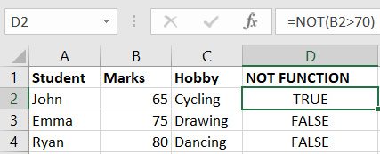
NOT Function
NOT Function : Changes TRUE to FALSE or FALSE to TRUE.
Syntax :
Example :
=NOT(B2>70)
NOT(Logical)

Slide 14
Introduction to Nested Functions
What are Nested Functions?
A nested function is a function placed inside another function.
The inner function is calculated first.
The result is then used by the outer function.
Used to perform multiple calculations in a single formula.

Slide 15
Nested Function
Combining multiple logical functions to solve complex scenarios
Example :
Nested IF Function
IF(condition , value_if_true , IF(condition , value_if_true, IF(condition , value_if_true , ......)
Nested IF- AND Function
IF(AND(condition1,condition2,.....),value_if_true,value_if_false)

Slide 16
Nested Functions using Logical Functions
1. IF with AND
=IF(AND(B2>=50,C2>=50),"Pass","Fail")
Logic:
Checks if both subjects have marks ≥ 50.
Returns Pass if both conditions are true.
3. Nested IF
=IF(B2>=75,"Distinction",IF(B2>=50,"Pass","Fail"))
Logic:
Marks ≥ 75 → Distinction
Marks ≥ 50 → Pass
Otherwise → Fail
2. IF with OR
=IF(OR(B2>=90,C2>=90),"Outstanding","Good")
Logic:
Checks if at least one subject has marks ≥ 90.
Returns Outstanding if any condition is true.

Slide 17
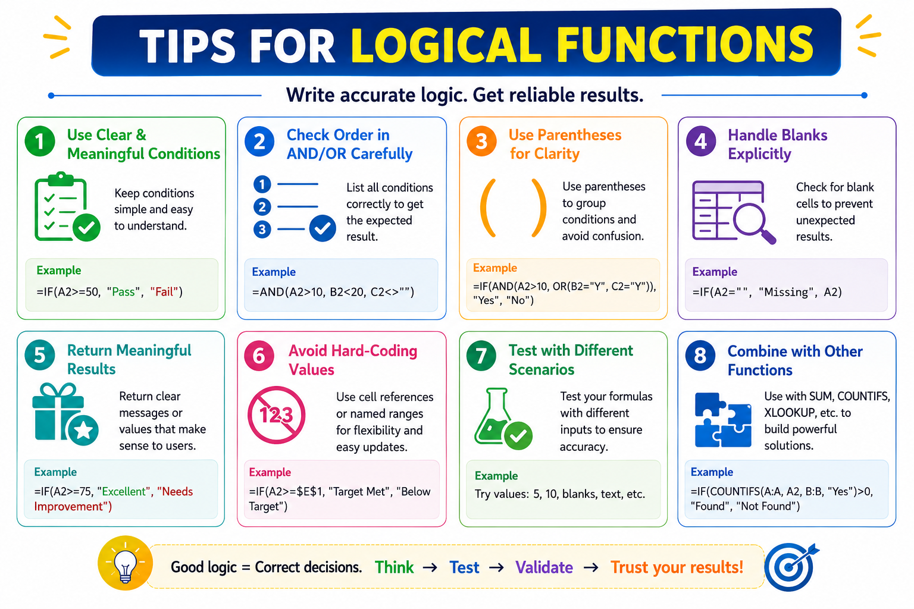

Slide 18
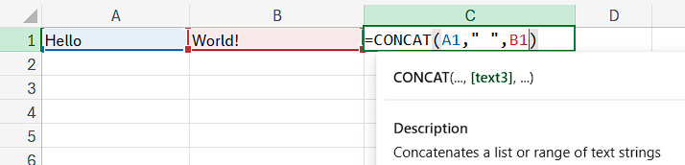
CONCAT Function
Joins text from multiple cells.
Formula: =CONCAT(text1, text2, …)
Example:
Use Case: Combine first & last names, merge address fields.
→ Hello World!

Slide 19
Similar Functions to CONCAT
Function/Operator | Purpose | Example | Result
CONCAT | Combines text without delimiters | =CONCAT(A1, " ", A2) | Hello World
TEXTJOIN | Combines text with a delimiter | =TEXTJOIN(", ", TRUE, A4) | Apple, Banana, Cherry
& | Concatenates text strings directly | ="Hello" & " " & "World" | Hello World

Slide 20

Fun Fact:
✨ Did you know?
Older Excel versions used CONCATENATE.
In Excel 2016+, CONCAT replaced it with more flexibility.

Slide 21

LEFT Function
Extracts characters from the start of text.
Formula: =LEFT(text, num_chars)
Example:
Use Case: Extract first few digits of ID or year from a date string.
→ Excel

Slide 22
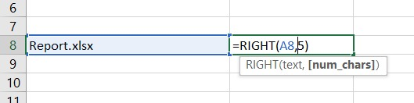
RIGHT Function
Extracts characters from the end of text.
Formula: =RIGHT(text, num_chars)
Example:
Use Case: Extract file extensions, last 4 digits of phone numbers.
→ .xlsx

Slide 23

MID Function
Extracts text from the middle.
Formula: =MID(text, start_num, num_chars)
Example:
Use Case: Extract numbers from IDs or codes.
→ 12345

Slide 24
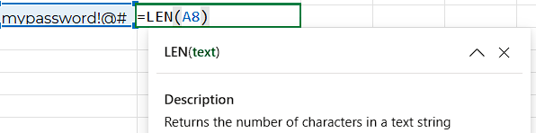
LEN Function
Counts the total number of characters in a string, including spaces and special symbols.
Formula: =LEN(text)
Example:
Explanation : "mypassword!@#" contains 13 characters, including special characters.
Use Case: Validate password lengths or ensure data integrity
→ 13

Slide 25

TRIM Function
Removes extra spaces from text, except single spaces between words.
Formula: =TRIM(text)
Example:
Use Case: Clean data imported from external sources.
→ Excel Tips

Slide 26

Question !
If A1 = “Data” and A2 = “Clean”, what will =CONCAT(A1,A2) return?
Answer: “DataClean”

Slide 27
Additional Functions for Handling Textual Data in Excel
Function | Purpose | Example | Result
UPPER() | Converts all text to uppercase letters | =UPPER("excel") | EXCEL
LOWER() | Converts all text to lowercase letters | =LOWER("EXCEL") | excel
PROPER() | Capitalizes the first letter of each word | =PROPER("data analyst") | Data Analyst
FIND() | Returns the position of a character or text within another text (case-sensitive) | =FIND("A","Data") | 2

Slide 28
FROM LOGIC TO TIME… ⏳
We’ve learned how Excel makes decisions using Logical Functions like IF, AND, and OR.
Now, it’s time to work with something just as powerful — Date & Time Functions.
TODAY() – Returns the current date
NOW() – Returns the current date and time
DATE() – Creates a date using year, month, and day
DATEDIF() – Calculates the difference between two dates

Slide 29
Understanding TODAY() and NOW()
1. Definition
TODAY(): Returns the current date without the time component. It updates automatically to reflect the current system date whenever the worksheet is recalculated.
NOW(): Returns the current date and time. Like TODAY(), it updates dynamically but includes the time component, accurate to the second.

Slide 30
Understanding TODAY() and NOW()
2. Syntax
Both functions are straightforward and do not take any arguments:
=TODAY()
=NOW()
3. Behavior
Both functions rely on the system clock of your computer.
They automatically recalculate when the worksheet is opened or recalculated manually or by another formula.

Slide 31
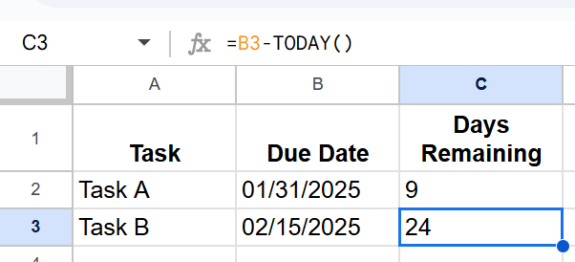
Practical Applications of TODAY()
1. Tracking Deadlines
Let’s say you’re managing a project and need to track deadlines relative to the current date.
Example:
Formula: =B2-TODAY()
Explanation: This subtracts the current date (returned by TODAY()) from the due date to calculate the number of days remaining.

Slide 32
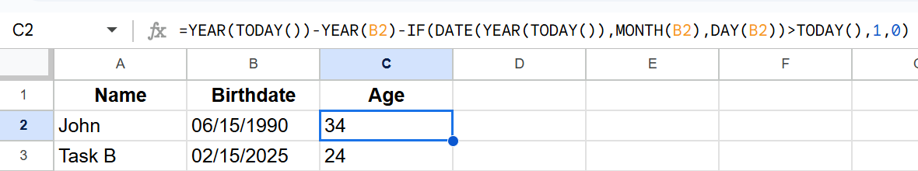
Practical Applications of TODAY()
2. Age Calculation
To calculate someone’s age based on their birthdate:
Example:

Slide 33
Practical Applications of TODAY()
Formula: =YEAR(TODAY())-YEAR(B2)-IF(DATE(YEAR(TODAY()),MONTH(B2),DAY(B2))>TODAY(),1,0)
Explanation: This calculates the difference in years and adjusts if the birthday hasn’t occurred yet this year.

Slide 34
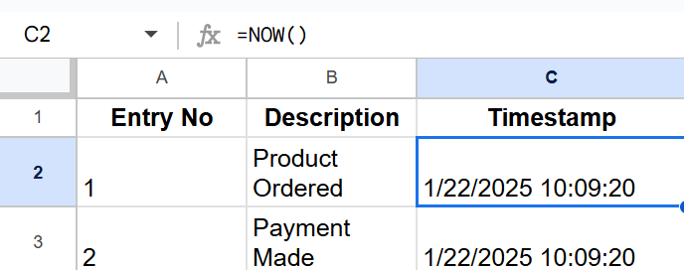
Practical Applications of NOW()
1. Timestamp for Data Entry
To record the exact date and time when data is entered:
Example:
Formula: =NOW()
Explanation: Every time you enter a new row, the current date and time are recorded dynamically.

Slide 35
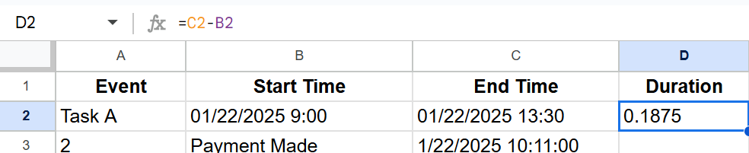
Practical Applications of NOW()
2. Calculate Time Differences
For time-sensitive operations, calculate the elapsed time between two events.
Example:
Formula: =D2-C2
Explanation: Subtract the start time from the end time to determine the duration.

Slide 36
Key Notes
Formatting Matters:
  Ensure cells using TODAY() or NOW() are formatted correctly (“Date” for TODAY() and “Custom > mm/dd/yyyy hh:mm” for NOW()).
Recalculation:
  These functions recalculate whenever the workbook is reopened or manually recalculated, so avoid overuse in large datasets to maintain performance.
Static Value:
  To keep a static value for the current date or time, use Ctrl+; for the date and Ctrl+Shift+; for the time.

Slide 37
Understanding DATEDIF and Date Differences
The process of calculating date differences is essential in various fields, including project management, finance, astronomy, and data analysis.
In Excel and Google Sheets, the DATEDIF function is commonly used to calculate the difference between two dates in terms of years, months, or days.
This guide provides an in-depth explanation of how to use the DATEDIF function, including theoretical background, practical examples, and step-by-step instructions.

Slide 38
Theoretical Background
Before we dive into the practical applications, let’s explore the underlying concepts:
What is a Date Difference?
  A date difference represents the time interval between two specific dates. Depending on your needs, you might want to express this difference in terms of:
    Days: The total number of days between two dates.
    Months: The number of full months between two dates.
    Years: The number of full years between two dates.

Slide 39
Theoretical Background
The Date Format
  In Excel or Google Sheets, dates are typically represented as serial numbers starting from January 1, 1900, which is represented by the serial number 1. Each subsequent day is incremented by 1. For example, January 2, 1900, is represented by 2, and so on.
The Role of DATEDIF
  The DATEDIF function computes the difference between two dates in a specified unit of time. It stands for "Date Difference," and it can handle differences in days, months, and years.

Slide 40
The Syntax of the DATEDIF Function
The basic syntax of the DATEDIF function is:
DATEDIF(start_date, end_date, unit)
start_date: The earlier date in the comparison.
end_date: The later date in the comparison.
unit: The unit of time you wish to return, which can be:
  "D": Days between the dates.
  "M": Complete months between the dates.
  "Y": Complete years between the dates.
  "MD": The difference in days, ignoring months and years.
  "YM": The difference in months, ignoring days and years.
  "YD": The difference in days, ignoring years.

Slide 41
Practical Examples
1. Calculating the Difference in Days
Suppose we have the following dates:
Start Date: January 1, 2025
End Date: January 22, 2025
We want to calculate the total number of days between these two dates.
Formula:
=DATEDIF("1/1/2025", "1/22/2025", "D")

Slide 42
Practical Examples
Result:
The difference is 21 days.
Explanation: Excel calculates the total number of days between January 1, 2025, and January 22, 2025, giving us the result of 21 days.

Slide 43
Practical Examples
2. Calculating the Difference in Complete Months
Now, let’s calculate the number of complete months between:
Start Date: January 1, 2025
End Date: June 15, 2025
Formula:
=DATEDIF("1/1/2025", "6/15/2025", "M")

Slide 44
Practical Examples
Result:
The difference is 5 months.
Explanation: This example counts only the full months between January 1, 2025, and June 15, 2025. Since we can't count partial months, it gives us 5 complete months.

Slide 45
Handling Edge Cases
Invalid Dates:
  If the start_date is later than the end_date, Excel will return an error (#NUM!). Always ensure the start_date is before the end_date.
Leap Years:
  DATEDIF handles leap years internally. For example, February 29 in a leap year will be taken into account when calculating date differences.
Partial Dates:
  The function counts only complete units. For example, if the date difference is 1 year and 2 months, it won’t count the partial month as an additional full year.

Slide 46
Use Cases for Date Differences
Project Management:
  When calculating project timelines, you can use DATEDIF to calculate the number of days, months, or years between the project start and end date.
Employee Tenure:
  To calculate the number of years an employee has worked in a company, you can use DATEDIF between the employee's start date and today’s date.
Loan Repayment:
  If you're calculating the number of months left on a loan, DATEDIF can help find the time difference between the loan origination date and the current date.
Subscription Renewals:
  If a subscription period is defined by months, you can calculate the number of months remaining before the subscription expires using DATEDIF.

Slide 47
Useful Excel Formulas
TODAY(): Returns the current date
NOW(): Returns the current date and time
DATE(year, month, day): Creates a date
TIME(hour, minute, second): Creates a time
TEXT(date, 'format'): Formats a date

Slide 48
Extracting Date and Time Components
YEAR(date): Returns the year of a date.
MONTH(date): Returns the month of a date.
DAY(date): Returns the day of the month of a date.
HOUR(time): Returns the hour of a time.
MINUTE(time): Returns the minute of a time.

Slide 49
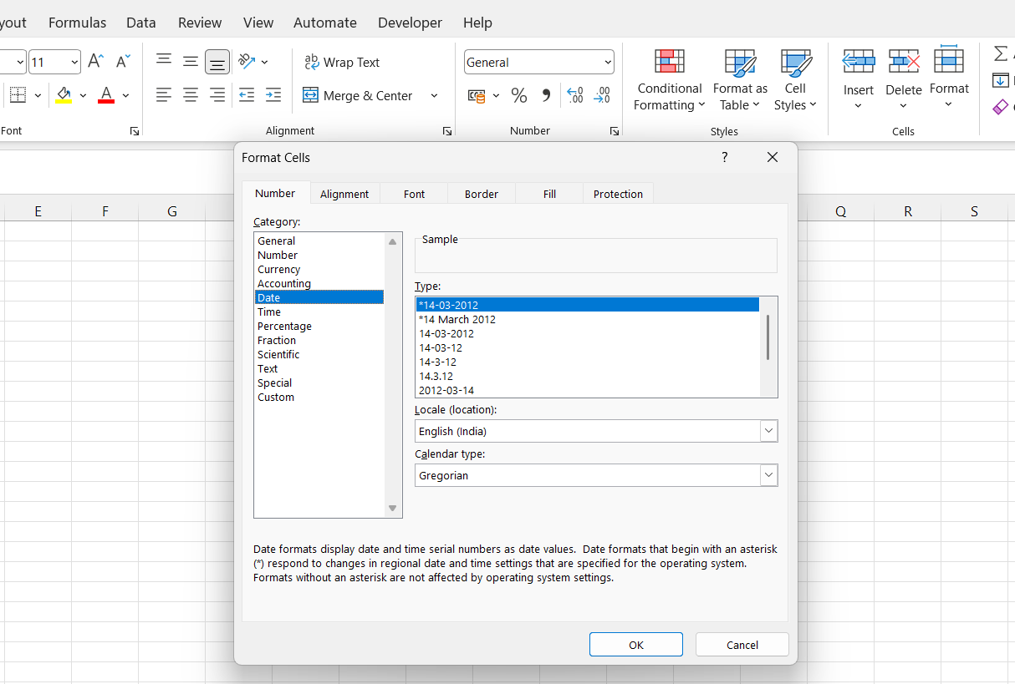
Common Date Formats
"dd-mmm-yyyy": Day-Month-Year (e.g., 22-Jan-2025)
"mm/dd/yyyy": Month/Day/Year (e.g., 01/22/2025)
"dddd, mmmm dd, yyyy": Full weekday name, full month name, day, year (e.g., Monday, January 22, 2025)

Slide 50
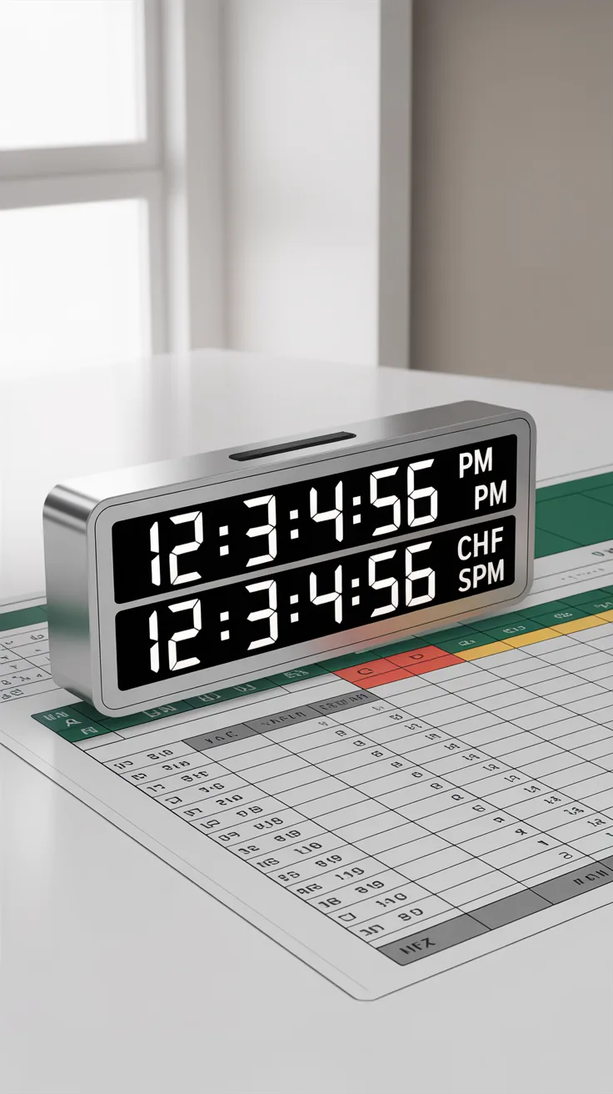
Common Time Formats
"hh:mm AM/PM": 12-hour format with AM/PM (e.g., 12:30 PM)
"hh:mm:ss": 24-hour format with hours, minutes, and seconds (e.g., 14:30:00)

Slide 51
Common Time Formats
Example Table
Original Date & Time | Formatted Date (dd-mmm-yyyy) | Formatted Date (mm/dd/yyyy) | Formatted Date (dddd, mmmm dd, yyyy) | Formatted Time (hh:mm AM/PM) | Formatted Time (hh:mm:ss)
2025-01-22 14:30:00 | =TEXT(A2, "dd-mmm-yyyy") | =TEXT(A2, "mm/dd/yyyy") | =TEXT(A2, "dddd, mmmm dd, yyyy") | =TEXT(A2, "hh:mm AM/PM") | =TEXT(A2, "hh:mm:ss")
2021-12-31 08:15:00 | =TEXT(A3, "dd-mmm-yyyy") | =TEXT(A3, "mm/dd/yyyy") | =TEXT(A3, "dddd, mmmm dd, yyyy") | =TEXT(A3, "hh:mm AM/PM") | =TEXT(A3, "hh:mm:ss")
2023-05-10 18:45:30 | =TEXT(A4, "dd-mmm-yyyy") | =TEXT(A4, "mm/dd/yyyy") | =TEXT(A4, "dddd, mmmm dd, yyyy") | =TEXT(A4, "hh:mm AM/PM") | =TEXT(A4, "hh:mm:ss")

Slide 52
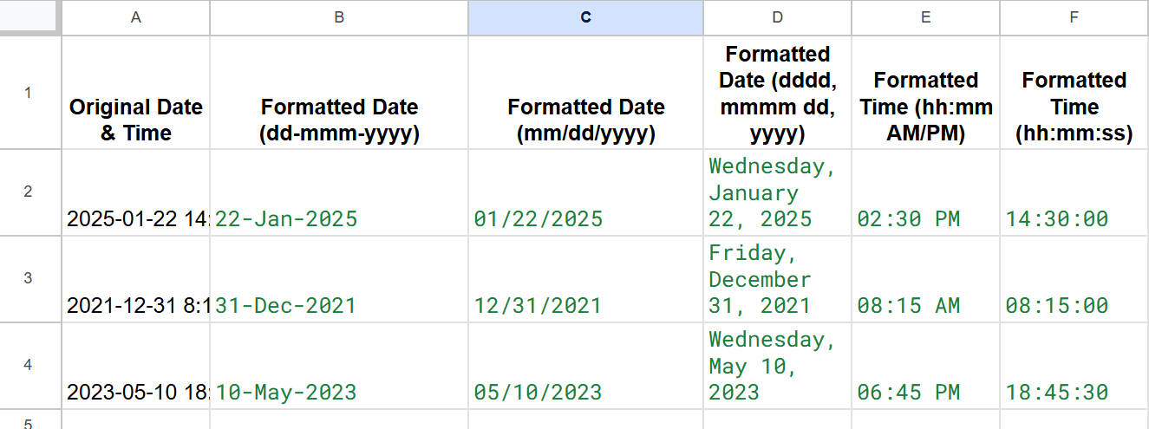
Common Time Formats
Output

Slide 53
Common Time Formats
Explanation
TEXT(A2, "dd-mmm-yyyy"): Converts the date in cell A2 into a day-month-year format (e.g., 22-Jan-2025).
TEXT(A2, "mm/dd/yyyy"): Converts the date into a month/day/year format (e.g., 01/22/2025).
TEXT(A2, "dddd, mmmm dd, yyyy"): Converts the date into a full weekday and month name format (e.g., Monday, January 22, 2025).
TEXT(A2, "hh:mm AM/PM"): Converts the time into a 12-hour format with AM/PM (e.g., 02:30 PM).
TEXT(A2, "hh:mm:ss"): Converts the time into a 24-hour format with hours, minutes, and seconds (e.g., 14:30:00)

Slide 54
WORKDAY Function
The WORKDAY function is used to calculate a date that is a certain number of workdays before or after a given date.
Syntax:
WORKDAY(start_date, days, [holidays])

Slide 55
WORKDAY Function
Where:
  start_date: The starting date.
  days: The number of workdays to add (can be negative to subtract).
  [holidays]: An optional list of holidays to exclude from the calculation.
Example:
=WORKDAY("2025-01-22", 10): Returns the date 10 workdays after January 22, 2025.

Slide 56
NETWORKDAYS Function
The NETWORKDAYS function calculates the number of workdays between two dates, excluding weekends and optionally, holidays.
Syntax:
NETWORKDAYS(start_date, end_date, [holidays])

Slide 57
NETWORKDAYS Function
Where:
  start_date: The start date.
  end_date: The end date.
  [holidays]: Optional list of holidays to exclude.
Example:
=NETWORKDAYS("2025-01-01", "2025-01-22"): Calculates the number of workdays between January 1 and January 22, 2025.

Slide 58
Example Table: WORKDAY and NETWORKDAYS
Start Date | End Date | WORKDAY (Add 10 Days) | NETWORKDAYS (Count Days)
2025-01-01 | 2025-01-22 | =WORKDAY(A2, 10) | =NETWORKDAYS(A2, B2)
2023-12-15 | 2024-01-10 | =WORKDAY(A3, 10) | =NETWORKDAYS(A3, B3)
2025-05-01 | 2025-05-15 | =WORKDAY(A4, 10) | =NETWORKDAYS(A4, B4)

Slide 59
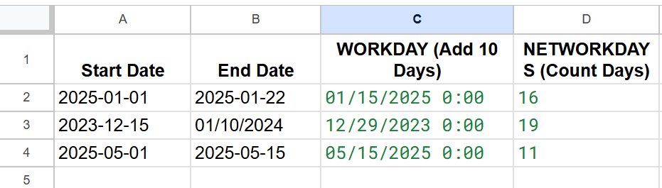
Example Table: WORKDAY and NETWORKDAYS
Explanation:
WORKDAY(A2, 10): Adds 10 workdays to the start date in cell A2.
NETWORKDAYS(A2, B2): Counts the number of workdays between the start and end dates in A2 and B2.

Slide 60
Example Table: Using Holidays
WORKDAY and NETWORKDAYS with Holidays
Start Date | End Date | WORKDAY (Add 10 Days, Exclude Holidays) | NETWORKDAYS (Count Days, Exclude Holidays)
2025-01-01 | 2025-01-22 | =WORKDAY(A2, 10, {"2025-01-10", "2025-01-15"}) | =NETWORKDAYS(A2, B2, {"2025-01-10", "2025-01-15"})

Slide 61
Example Table: Using Holidays
2023-12-15 | 2024-01-10 | =WORKDAY(A3, 10, {"2023-12-25", "2024-01-01"}) | =NETWORKDAYS(A3, B3, {"2023-12-25", "2024-01-01"})
2025-05-01 | 2025-05-15 | =WORKDAY(A4, 10, {"2025-05-05", "2025-05-10"}) | =NETWORKDAYS(A4, B4, {"2025-05-05", "2025-05-10"})

Slide 62

Let’s Apply What You Learned!
You are working on a project tracker in Excel.
Start Date: 1-Jan-2025
Today’s Date: (should update automatically)
You want to calculate how many days are left to complete the project.
Which formula would you use?
A) =DATEDIF("1-Jan-2025", TODAY(), "D")
B) =TODAY() - "1-Jan-2025"
C) ="1-Jan-2025" - TODAY()
D) =DATE() - TODAY()
Challenge:
How would you modify the formula to show “Overdue” if the deadline has passed?

Slide 63
ANSWER & EXPLANATION
✔️ Correct Answer: C) ="1-Jan-2025" - TODAY()
Explanation:
This formula calculates the remaining days from today to the deadline.
If the result is positive → days left
If the result is negative → project is overdue
Solution (Overdue Condition):
=IF("1-Jan-2025" - TODAY() < 0, "Overdue", "On Track")
Key Learning:
Use TODAY() for dynamic date updates
Subtract dates to calculate duration
Combine with IF() for real-world insights

Slide 64
SESSION SUMMARY
In this session, we explored how Excel functions help us transform raw data into meaningful insights.
Logical Functions
IF, AND, OR for decision-making
Nested functions for complex conditions
Text Functions
CONCAT, LEFT, RIGHT, MID, LEN, TRIM
Cleaning and transforming textual data
Date & Time Functions
TODAY(), NOW(), DATE(), DATEDIF()
Managing and analyzing time-based data
Key Takeaways:
Automate calculations using functions
Build smarter and dynamic formulas
Clean, transform, and analyze data efficiently
Apply functions in real-world scenarios

Slide 65
Thank You for Attending the Session
“Mastering Excel functions is the first step toward becoming a great Data Analyst!”
Keep Learning, Keep Upskilling!

